Slide 1


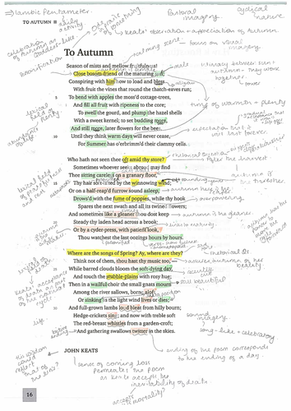










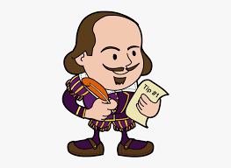





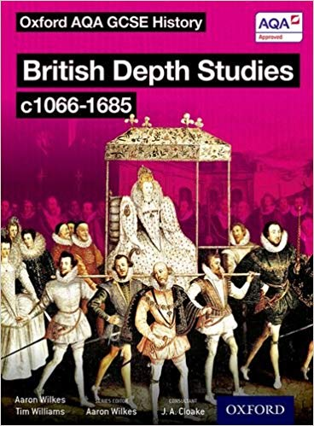





The Journey: GCSE ENGLISH at Earl Mortimer College
Year 9
GCSE Literature
Anthology
Literature
Unseen Poetry
Year 10
Language
20th Century Reading
Language
Creative Writing
Literature
An Inspector Calls
Literature
Anthology Revision
Literature
Macbeth or Romeo and Juliet
Language
19th and 21st Century Reading
Language
Spoken Language Presentations
Language
Transactional Writing
Year11
Language 19th and 21st Century Reading
Literature
A Christmas Carol
Language
Revision
Literature Revision
Exams
Language
20th Century Reading

Slide 2

What will I learn in GCSE Language?
AO1 · Identify and interpret explicit and implicit information and ideas · Select and synthesise evidence from different texts
AO2 Explain, comment on analyse how writers use language and structure to achieve effects and influence readers, using relevant subject terminology to support their views
AO3 Compare writers' ideas and perspectives, as well as how these are conveyed, across two or more texts
AO4 Evaluate texts critically and support this with appropriate textual references
AO5 · Communicate clearly, effectively, and imaginatively, selecting and adapting tone, style and register for different forms, purposes and audiences · Organise information and ideas, using structural and grammatical features to support coherence and cohesion of texts
AO6 Candidates must use a range of vocabulary and sentence structures for clarity, purpose and effect, with accurate spelling and punctuation.
What will I learn in GCSE Literature?
AO1 Read, understand and respond to texts. Students should be able to: · maintain a critical style and develop an informed personal response · use textual references, including quotations, to support and illustrate interpretations.
AO2 Analyse the language, form and structure used by a writer to create meanings and effects, using relevant subject terminology where appropriate.
AO3 Show understanding of the relationships between texts and the contexts in which they were written.
AO4 Use a range of vocabulary and sentence structures for clarity, purpose and effect, with accurate spelling and punctuation.
You will learn these throughout your daily lessons. Each lesson will be linked to an Assessment Objective.

